Slide 1

PHISHING GUARD AI DETECTION
AI SHIELD
"Detect. Defend. Deliver Trust."
A next-generation AI-powered phishing detection system that prevents cyber fraud before it happens.

Slide 2

The Problem: Phishing is the #1 Cyber Threat
Massive Scale
High Impact
Over 3.4 billion phishing emails are sent daily, making it the most successful and damaging cyberattack method.
Attacks lead to identity theft, significant financial losses, and compromised corporate and personal systems.
Evolving Threat
The rise of AI-generated phishing and deepfake scams has rendered traditional defenses ineffective.

Slide 3


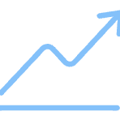

AI SHIELD: Solution Overview
Phishing Guard AI uses Machine Learning (ML) and Natural Language Processing (NLP) to analyze, detect, and neutralize phishing attempts in real-time across multiple channels.
AI Detection Engine
Real-Time Integration
Deep neural models trained on text, images, and URLs for high accuracy.
Detects malicious links directly within browsers, email clients, and text messages.
Adaptive Learning
Secure Dashboard
Continuously improves detection capabilities through user feedback and new threat data.
Provides visual threat reports and protection status for users and enterprises.

Slide 4
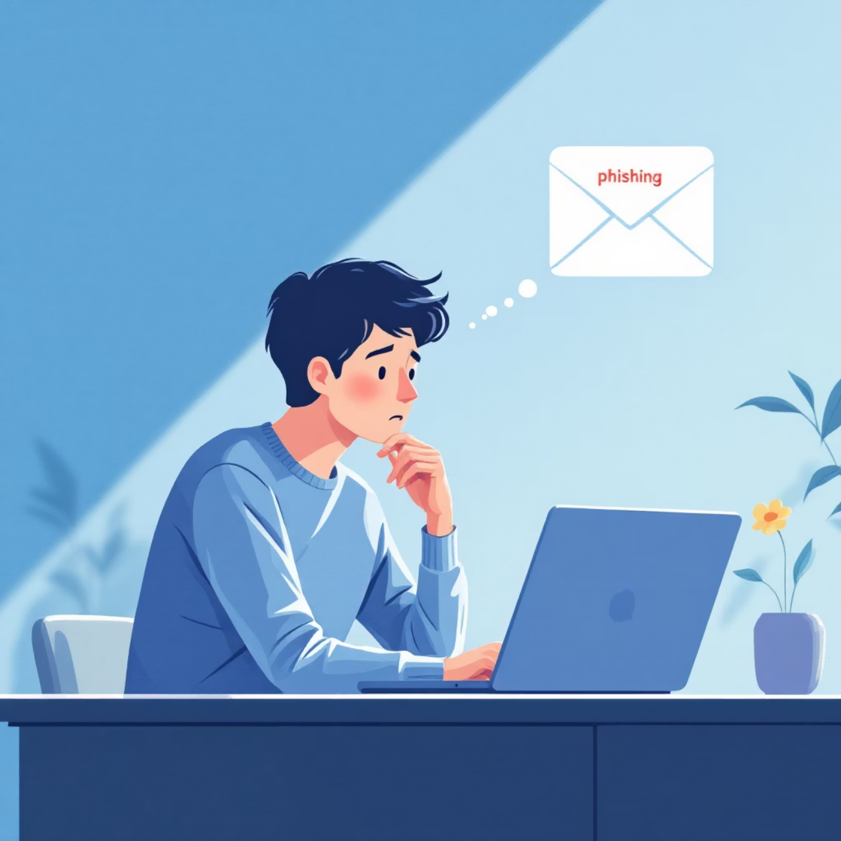

Desirability: Why Users Need AI SHIELD
Phishing is the Entry Point
Sophistication Requires AI
90% of all cyber breaches originate with a successful phishing attempt.
Most users cannot identify today's sophisticated, AI-generated phishing content.
Enterprise Risk Mitigation
Enterprises lose millions annually; AI SHIELD offers critical protection.
User Validation: Surveys show 87% interest in using AI-based phishing defense.

Slide 5
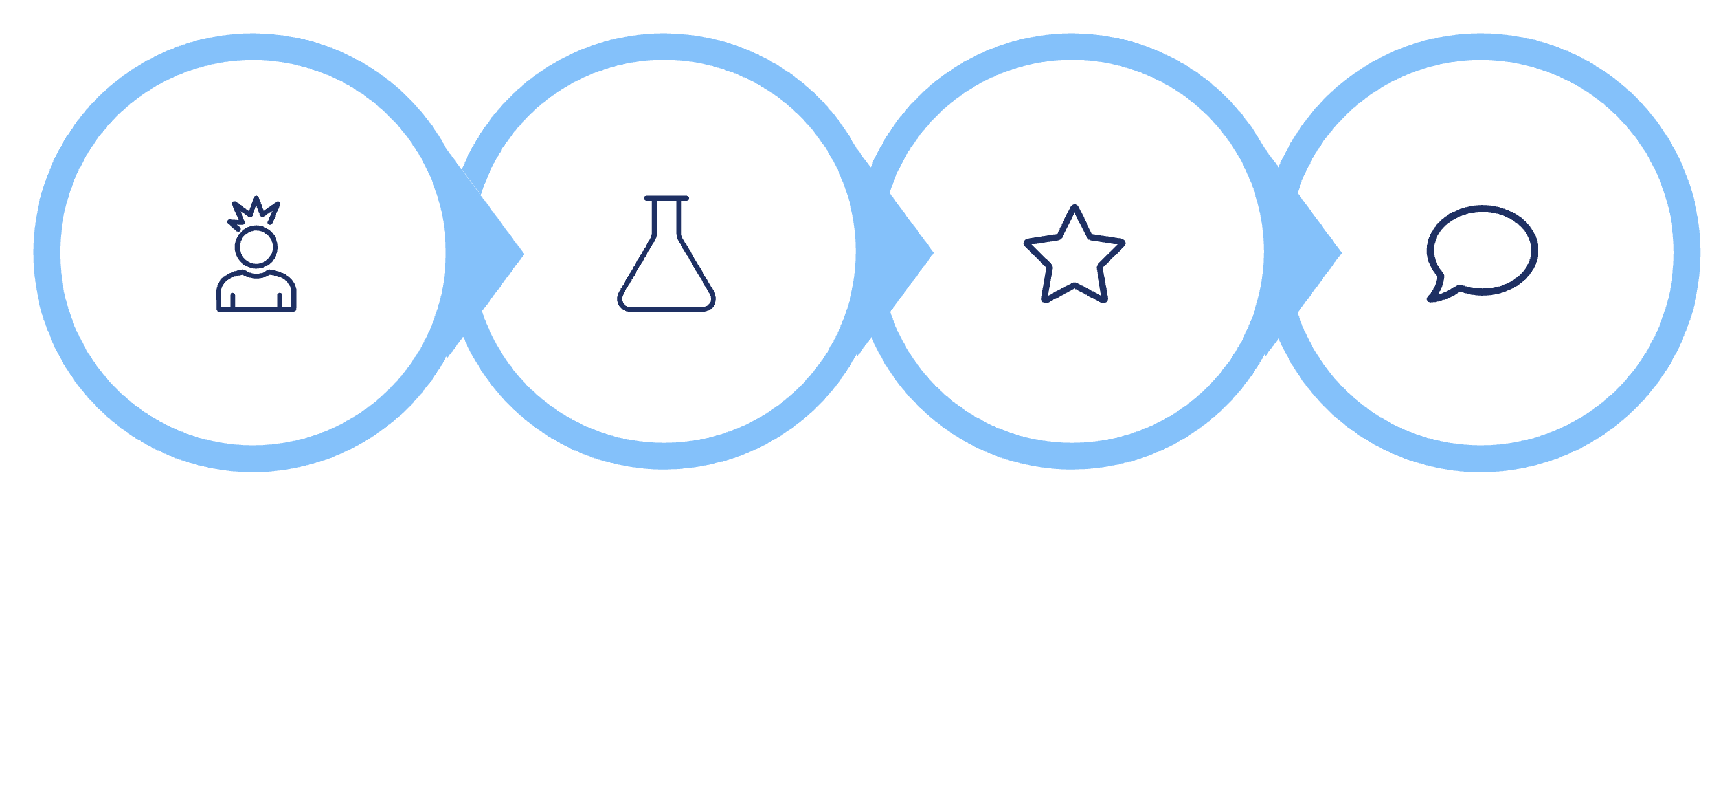




Feasibility: Our Technical Foundation
AI SHIELD is built on a robust, scalable, and cloud-native architecture designed for high performance and reliability.
React.js
Python Flask
TensorFlow
MongoDB
The modular, cloud-hosted system features an AI inference layer that efficiently returns real-time phishing risk scores to the user dashboard.

Slide 6

Viability: Market Opportunity & Sustainability
$2.5B
Market Projection
Projected size of the global phishing protection market by 2028.
Revenue Model
Freemium for individuals, paid tiers for enterprises, and API integration services.
Scalability is ensured through containerization using Docker and Kubernetes for rapid, global deployment.

Slide 7
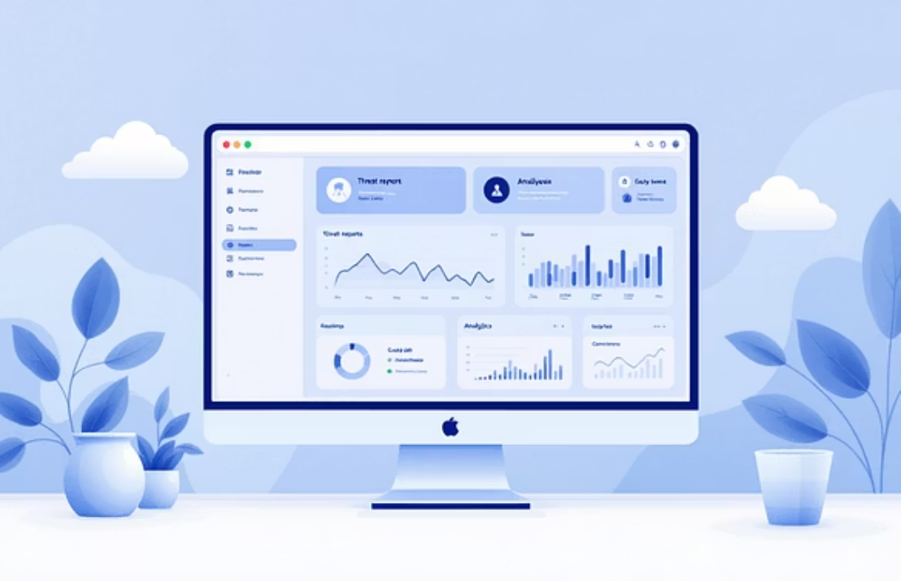
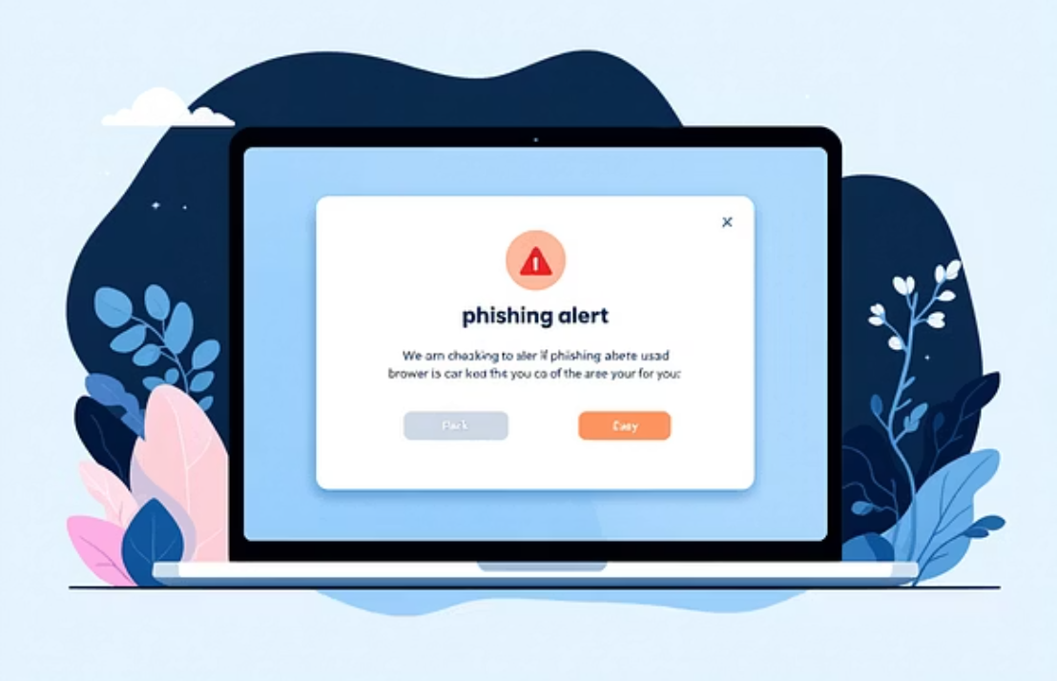
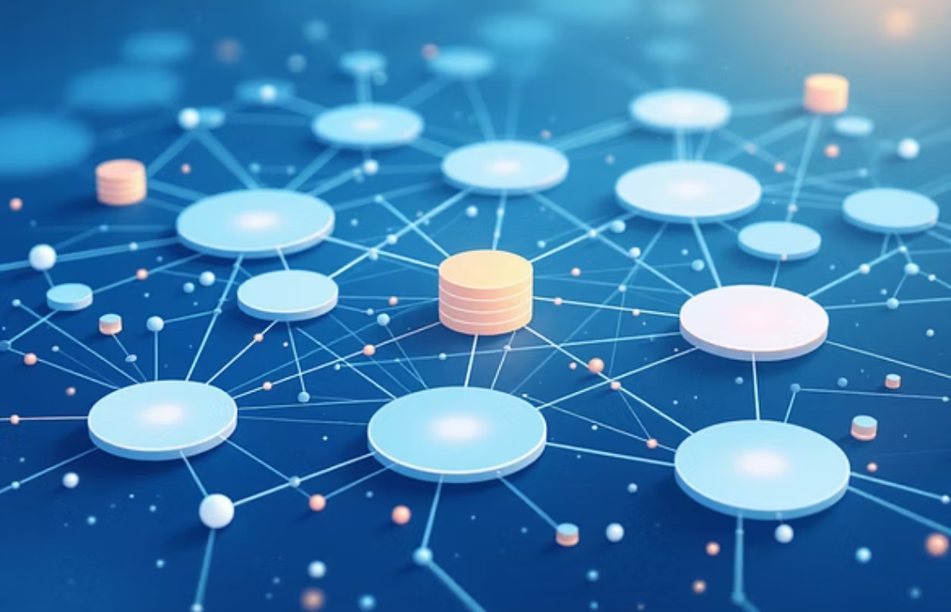
Prototype & Developed Features
We have successfully developed and tested core components of the AI SHIELD system.
ML-based detection API and web dashboard are functional.
Browser extension prototype is ready for integration.
Proprietary dataset of 40,000+ phishing samples for model training.

Slide 8



Roadmap to Launch
30 Days
60 Days
90 Days
Expand dataset and refine the core detection model for higher accuracy.
Integrate browser and Outlook extensions for seamless user protection.
Launch enterprise version and initiate targeted outreach campaigns.
Long-Term Goal: Evolve into a global AI-powered Cyber Resiliency Suite.

Slide 9


The AI SHIELD Team
S. Ajay
Zubair Zaman
Project Lead & Frontend Developer
Backend developer
Transforming data into reliable, high-performance backend solutions
Designs React.js dashboard and user analytics interface.
Mohammad Arshath
API & Security Developer
Handles key management, encryption, and authentication modules.

Slide 10
Our Ask
Mentorship
Resources
Collaboration
Guidance in cybersecurity product scaling and market strategy.
Cloud credits to support our growing AI infrastructure.
Opportunities with government or academic cybersecurity programs.
AI SHIELD — Empowering trust in the digital world. Together, let's outsmart phishing before it outsmarts us.

Slide 11

Thank You & Call to action
We appreciate your attention to AI SHIELD, our innovative solution for a safer digital future. Together, we can build a world free from phishing threats.
Let's connect:
Email: ajays261207@gmail.com | LinkedIn: Ajay S.
GitHub: ajays261207-pixel

